Slide 1
Panel: W3C and SDO alignment
W3C Web and TV Workshop
Munich 12th March 2014

Slide 2
Panel: W3C and SDO alignment
Moderator:
Giuseppe Pascale, Opera Software
Panelists
EBU: Jean-Pierre Evain (EBU)
HbbTV/OIPF: Jon Piesing (TP Vision)
IPTV Forum Japan: Kinji Matsumura (NHK)
UPnP/DLNA: Clarke Stevens (CableLabs)
W3C: Philipp Hoschka (W3C)

Slide 4
European Broadcasting Union: EBU
Largest professional association of broadcasters, worldwide covering 75 countries
The Eurovision & Euroradio networks for special events, news, sports, concerts (coverage and contribution) with offices in Beijing, Brussels, Moscow, New-York, Rome, Singapore, Washington
Radio and television co-productions in entertainment and culture
Training at the EBU Academy
Technology and Innovation: addressing all technical aspects of radio-television production / distribution and frequency planning.
EBU is a member of HbbTV and other key industrial consortia.

Slide 5
EBU and W3C
EBU joined W3C in 2008
Main points of interest among many others:
HMTL-5 (incl. Accessibility) for radio and TV
Media Annotation and Fragments Working Groups
EME
Schema.org and metadata (e.g. distribution data, sport)
Web&TV
Overlap:
Timed text – latest EBU specification: EBU-TT-D, adopted by DVB-DASH and HbbTV
Audio modelling (object audio) and also Loudness
Metadata: programme guides, technical and descriptive metadata, ontologies (bringing RDF in Radio/TV production)
Questions:
Where is the expertise? Who drives what?
Who should benefit from the work done in W3C?

Slide 6
HbbTV System and Specification Overview
For W3C Web and TV Workshop
Munich 12th March 2014

Slide 7
HbbTV v1 System Overview

Slide 8
HbbTV v2 Specification Overview
HbbTV Specification
Vol. 5
DAE
Vol. 2
Media Formats
EN 300 468
DVB-SI
TS 102 zzz
DASH
TS 102 809
TS 102 zzz
CSS
TS 101 154
Vol. 7
Content & Service Protection
TS 103 205 ext. to CI Plus
DVB
Web Standards
TV Profile
CI Plus
Video and Audio
Codecs
OIPF
Tech-3380
“EBU-TT-D”
EBU
23009-1 DASH
CEA-2014
HTML5
CSS3..
DOM3..
.....
TTML
…...
23001-7 CENC
CEA
W3C
ISO/IEC “MPEG”

Slide 9
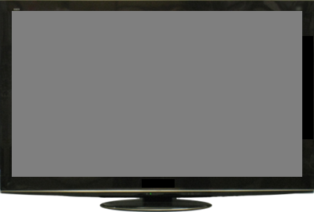

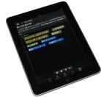
Technology Overview of Hybridcast
Broadcaster
Broadcast
Hybridcast Receiver
HTML5 browser
AIT
App
Extension for hybrid use
API
Service Provider
Receiver functions
App control
and
management
Companion
device control
Broadcast
reception
and decode
Web
services
AIT
App
App server
Broadband
network
Companion Device
Connection and Messaging
* AIT: Application Information Table
App
Companion Device
Notes:
Blocks in red are the areas specified in Hybridcast’s technical spec.
memo: Hybridcast spec does not define profile for use of W3C standards, such as HTML elements, APIs and etc.

Slide 10

W3C Web & TV Workshop 2014
UPnP, W3C and TV
W3C
Web & TV Workshop
March 2014

Slide 11
The Future of TV…
HTML user interfaces
Devices figure it out on their own
Multiple screens
Integration with the Internet of Things

Slide 12

UPnP HTML5 RUI
HTML5 RUI profile for UPnP/DLNA Clients to render remote application UIs with content.
Discovery based on UPnP Remote User Interface specification.
HTML5 <video> tag for video playback within UI pages
Extensions to support DLNA streaming w/ trick modes and DTCP-IP.
Single profile conformant to W3C specs and commercial browser implementations.
Provides a consistent user experience on connected devices
Smart TVs, game consoles, Blu-ray players, phones, and tablets
A single unified user interface adapted to screen resolution.
Support for regulatory and contractual services such as EAS, closed captions, Parental Controls, ad-insertion, etc.

Slide 13
UPnP and W3C Evolution
HTML pages can discover available user interfaces using the W3C Network Services Discovery (NSD) (currently in working draft in DAPI) and UPnP Remote User Interface specification
The user interfaces, in turn, are being developed in HTML and can use NSD, XHR and WebSockets to discover and control televisions, media servers, lighting, blinds, etc.
The new UPnP Internet of Things extends this interaction across the Internet and integrates web services

Slide 14
Multi-screen Interaction Model
Companion screen device (e.g., smart phone, tablet, TV)
Main screen device
(e.g., TV, smart phone)
Screen
Control Point
UPnP Actions
Screen
Device
UPnP Eventing
Screen
Device
UPnP Actions
Screen
Control Point
UPnP Eventing
Out-of-Band
App-to-App Communication
The Extended Interaction Model can provide more sophisticated interactions and flexible architectures. I.e., it allows Main screen devices to interact with each other, and Companion screen devices to interact with each other.

Slide 15
UPnP Cloud Interaction (MUC)
MUC
Room
Meet
User A
User B
UCCD
UCCD
UCC-CP
UCC-CP
B
A
UCCD
UCCD
User A - Create Room (MUC)
User A - Invite UCCDs and UCC-CPs (A&B)
User A & B - Meet and share
MUC = Multi User Chat

Slide 16

For the interconnected lifestyle

Slide 17
DLNA CVP-2 Overview for W3C
Premium content on any device, in any room

Slide 18



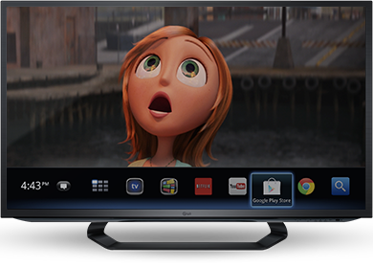
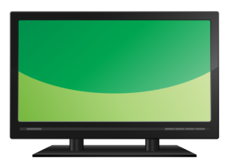

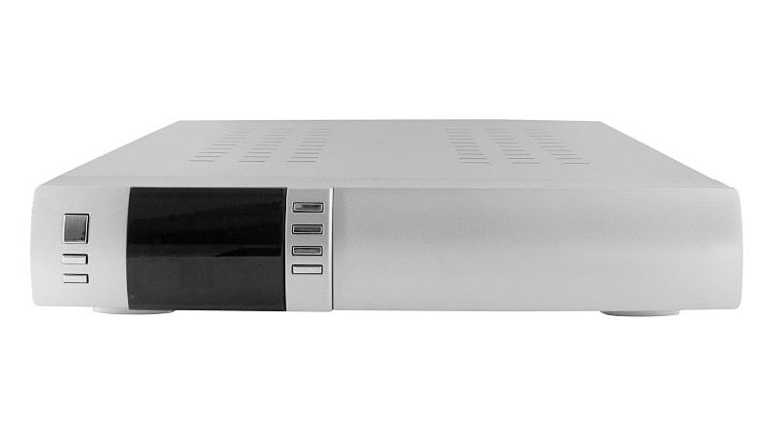


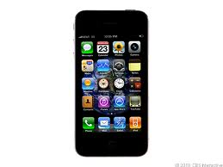
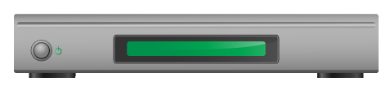
DLNA CVP-2 Guidelines and Test
Premium content on any device, in any room with consistent service provider UI
Laptop
Tablet
Smart TV
Wi-Fi
Ethernet
MoCA
HomePlug AV
HD-PLC
HPNA
Wi-Fi Direct
Service Provider
Set Top Box/Gateway
Game Console
Smart Phone
Blu-Ray Player
Notes:
CVP-2 Benefits:
Enables streaming of service provider content (e.g. live, on-demand, DVR) to retail devices (e.g. televisions, PCs, phones, tablets, Blu-ray disc players, and game consoles) with consistent service provider user interface across all CVP-2 devices from different manufacturers
Preserves the rights of content providers
Allows access to all service provider services in every room without the need for service provider supplied STBs in every room

Slide 19
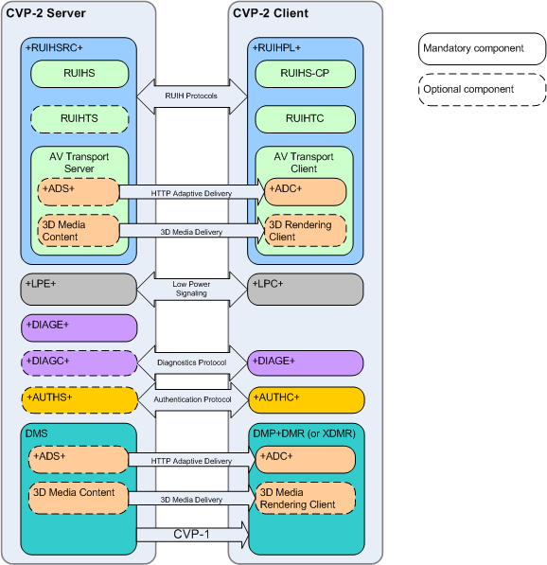







DLNA CVP-2 Guidelines and Certification
Multi-Industry Effort in DLNA
Development Led by:
Status:
Technical Specifications to be published in March 2014
Certification launch scheduled for end of September 2014
Notes:
CVP-2 Features:
HTML5 RUI
Authentication of DLNA Certification (using DTCP-IP keys)
Diagnostics
Networked Devices Power Save (Low Power)
HTTP Adaptive Delivery (MPEG-DASH)
MPEG-2 and AVC Video in MPEG-2 TS and MP4 containers
ETV, Ad-Insertion & other TV Services signaling in MPEG2-TS
3D Media Formats (conditionally mandatory for devices supporting 3D video)
Multi-Industry effort in DLNA:
Development led by service providers in conjunction with CE manufacturers and technology suppliers (Broadcom, BSkyB, CableLabs, Comcast, Cox, Time Warner Cable, Samsung)
Acronyms:
+RUIHSRC+: HTML5 RUI Server Capability
+RUIHPL+: HTML5 RUI Pull Controller
RUIHS: UPnP HTML5 RUI Server Service
RUIHS-CP: UPnP HTML5 RUI Server Service Control Point
RUIHTS: HTML5 RUI Transport Server
RUIHTC: HTML5 RUI Transport Client
ADS: Adaptive Delivery Server
ADC: Adaptive Delivery Client
DMP: Digital Media Player
DMR: Digital Media Renderer
XDMR: Extended DMR
DIAGE: Diagnostics Endpoint
DIAGC: Diagnostic Controller
LPC: Low Power Controller
LPE: Low Power Endpoint
AUTHS: Authentication Server
AUTHC: Authentication Client

Slide 20
DLNA CVP-2 Specification Features
Baseline: CVP-1 Features: DMP+DMR, DTCP-IP Link Protection, HTTP Transport w/ Trick Modes, Priority-Based QoS, MPEG-2 & AVC Video in MPEG-TS
HTML5 RUI
Includes mapping for MSO TV services (closed captions, Ad-Insertion, SAP, etc.) signaling in MPEG2-TS
Authentication of DLNA Certification (using DTCP-IP keys)
Diagnostics
Networked Devices Power Save (Low Power)
HTTP Adaptive Delivery (MPEG-DASH)
MPEG-2 and AVC Video in MPEG-2 TS and MP4 containers
3D Media Formats (conditionally mandatory for devices supporting 3D video)

Slide 21


CVP-2 Hybrid In-home + Cloud Scenario
Cloud HTML5 RUI/Server
2. HTML5 RUI Guide
3. Linear, On-Demand, DVR Content
Home Network
DLNA CVP-2 TV
CVP-2 STB/ Gateway
1. Device and Service Discovery
Notes:
RUI Server and Authentication Server component are located in the cloud
Only A/V Server component is in the service provider supplied STB in the home
Architecture that provides transition path for cloud to ground (or All-IP) content delivery

Slide 22



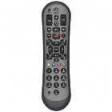
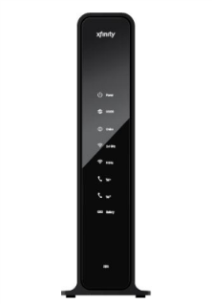
Live Linear Streaming
6. Settop tunes channel and streams content to COAM device
HDMI
Hybrid STB
Account Server
1. User enables DLNA via STB UI
RUI Server
2. STB publishes RemoteUIServer Service
3. COAM User Agent discovers and parses UI listing and loads and launches RUI
4. RUI reserves STB tuner
5. RUI calls play on HTMLMediaElement, which causes COAM User Agent to send HTTP HEAD/GET requests to STB
CVP-2 Certified
COAM Device
Data Gateway

Slide 23

Questions
Contact: Amol Bhagwat
a.bhagwat@cablelabs.com
303-661-3333

